Slide 1
Coffee & Code:
Creating digital exhibits with Omeka
Sarah DeLorme & Anna Kijas • 11 April 2019
GitHub.com/BCDigSchol/coffee-code
http://bit.ly/2UMyWZD

Slide 2
Today’s session
Overview of Omeka
Metadata! Or, describing items for digital collections
Exercise 1. Describe an item
Share with group
Exercise 2. Create an item record in Omeka
Share with group

Slide 3
Overview of Omeka

Slide 4
Omeka Flavors
Omeka.net
Hosted
Limited plugins & themes, based on plan
File size limits
Free trial
Omeka Classic (or Omeka.org)
Self-hosted (requires a server)
Unlimited plugins & themes
Size limits depend on server
Free...ish
Omeka S
Newest
Requires a server
Multi-site capabilities

Slide 5
What kinds of resources can you create in Omeka?
Items: individual descriptive metadata records, or building blocks
Collections: groups of items
Exhibits: curated items with deep contextualization, essays, or teaching materials
Pages: additional web pages, e.g. ‘About’ or ‘Credits’
Examples
A History of US Public Libraries, https://dp.la/exhibitions/history-us-public-libraries
Omeka.net Showcase, https://info.omeka.net/showcase/
Notes:
Sarah: give a little tour of some of the examples.

Slide 6
Questions to ask yourself while planning
What are the primary goals of the website?
Who is the primary audience of this website?
What sections will this website include?
What will I do with items in this website?
See the Omeka Classic User Manual for these and other questions to ask yourself while conceptualizing your digital exhibit.

Slide 7
Metadata! Or, describing items for digital collections

Slide 8
Metadata and its nature
Analytical Bibliography — A listing of works that indicates in precise details the name of the author, the exact title of the work, and publication details, and that emphasizes the material nature of the work, including the format, the pagination, typographical particulars, illustrations, and other characteristics, such as the kind of paper and binding.
Society of American Archivists glossary
Notes:
Not the content of items, but the material nature, its reliability, its social context, provenance. As humanities research and teaching moves away from the printed book and into the digital world, you need something that performs a similar function for digital objects. What are you looking at? Social or historical significance or non-significance? So you know what you’re using in two or three different levels.

Slide 9
Metadata and its uses
Short and sweet (mostly — what about ‘Description’?)
Uniform (mostly — what about author name ambiguities? ‘Condition’?)
Linkable (mostly — not all metadata is usefully linked)
Useful (mostly — different metadata fields have different audiences)

Slide 10
To describe an item, ask yourself?
What is is the item of ?
What is the item about ?

Slide 11
What are you describing?
Boston landmark?
Photo of the Boston landmark?
Digital file of the photo of the Boston landmark?

Slide 12
2 kinds of descriptive metadata
Fields — the buckets into which you place your description, e.g. ‘Title’ or ‘Subject’
Which are required? Which recommended?
Values — the items you place in the bucket
Will you use title case or sentence case in titles? Supplied information in brackets?
Are you going to draw your subjects from a limited list of terms so that you don’t use two different words to describe the same thing?
The upshot? Be consistent across records!

Slide 13
Today we’ll focus on item description
Which of the Dublin Core Metadata Initiative’s Element Set apply to your item? Remember that you don’t have to use all of them.
Some elements require decisions about the extent of explanation and context your metadata will provide, as in the ‘Description’ and ‘Relation’ fields.
Other elements, such as ‘Date’, call for straightforward, factual information—but there are exceptions here!

Slide 14
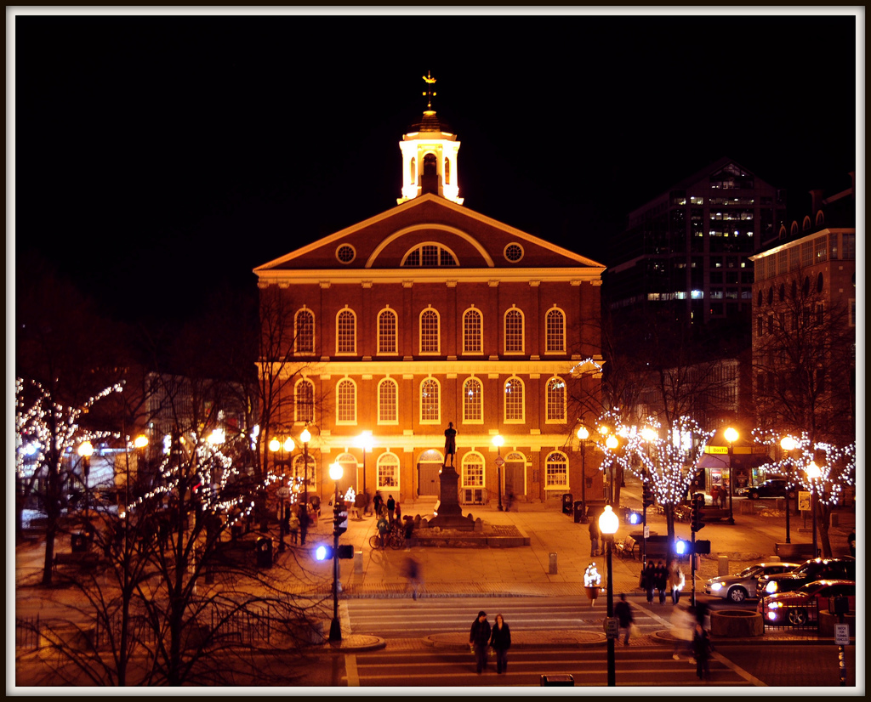
Faneuil Hall, Boston, Massachusetts
Image from Tony Fischer, “Faneuil Hall, Boston,” https://www.flickr.com/photos/tonythemisfit/3296056687. CC-BY 2.0.
Notes:
https://en.wikipedia.org/wiki/Faneuil_Hall

Slide 15
Exercise 1.
Describe an item

Slide 16
Exercise 1: Describe an item
Drawing upon the image provided, describe one or both items below adhering to the structure of the Dublin Core metadata elements. Create your description(s) using the provided worksheet.
Image metadata can be found in image-metadata.csv file in https://github.com/BCDigSchol/coffee-code repository
Notes:
Sarah

Slide 17
Exercise 2.
Create an item record in Omeka

Slide 18
Demo
Creating an item record in Omeka.net
Notes:
Anna

Slide 19
From items to collections: in theory
The most useful organizing properties for information resources are those based on their content and meaning, and these are not directly apparent when you look at a book or document . . .
The most effective organizing systems for information resources often are based on properties that emerge from analyzing the collection as a whole.
The Discipline of Organizing, ed. Robert J. Glushko, p. 15
Notes:
The point of this slide is about creating connections, relationships between items.

Slide 20
From items to collections: in practice
What connections among items do you want to create?
How would you create these connections through metadata?

Slide 21
Discussion
Are there applications for course-based work or a project?
Who are potential collaborators?
What projects might not be a good fit for Omeka?

Slide 22
Questions?
Sarah DeLorme - sarah.delorme at bc dot edu
Anna Kijas - anna.kijas at bc dot edu
Digital Scholarship at Boston College - ds.bc.edu
Credits: Modified slides based on Chelcie Rowell and Stephen Sturgeon’s April 28, 2018 workshop - https://github.com/BCDigSchol/coffee-code/tree/master/Omeka/Omeka-2018

